Slide 1


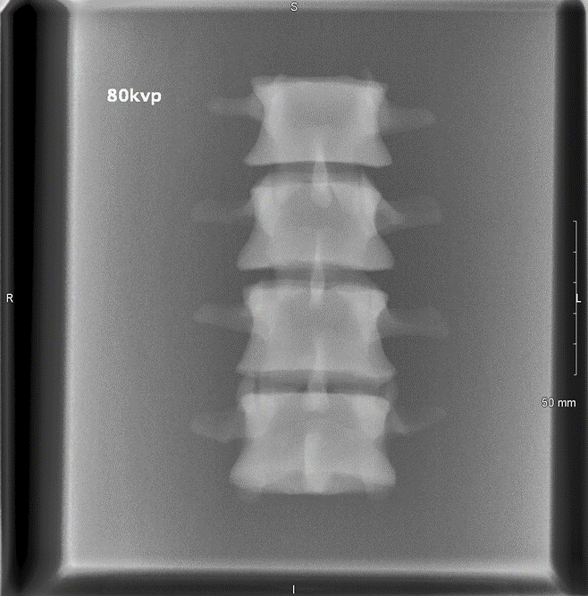
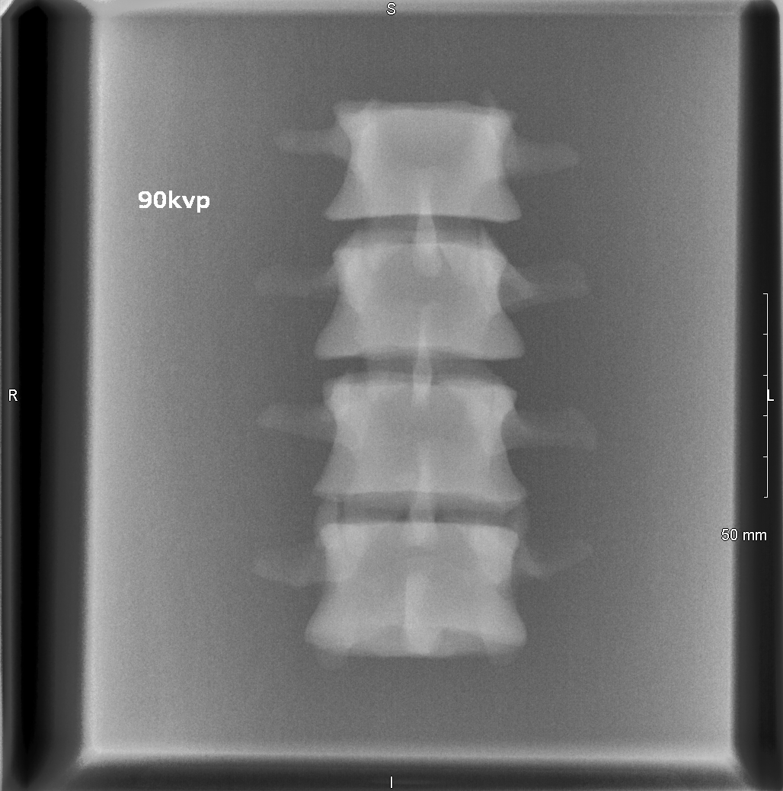
Increasing kV for high dose x-rays reduces the patient dose without affecting image quality
Shauna Murphy, Lee o’hora
Diagnostic Imaging, Mater University Hospital, Dublin 7.
Introduction: “Dose creep”
methodology
once higher kVps were used. Clinically significant (p < 0.05) patient median dose reductions of 33.7%, 21.3%, 14.85% and 31.41% were demonstrated for AP and lateral lumbar spine, abdominal and pelvic radiographs respectively.
Abdomen, Pelvis and Lumbar Spine X-rays account for a large number of the inpatient and outpatient examinations under taken in the Mater Hospital. Although not as documented as the CT Patient dose increases, DR exposure doses have seen an increase in recent years described as a “dose creep” (Herrmann et al. 2012). This could be down to a number of factors such as radiographer’s reliance on post processing capabilities of CR and DR radiography, easily repeated DR images etc. Perhaps the most prevalent cause of this ‘dose creep’ trend may be a failure, on Radiology departments internationally to respond appropriately to advances in DR radiography and adjust exposure factors.
According to the American Society of Radiological Technologist’s ‘Best Practices in Digital Radiography’ publication 2012;
“Increasing the kVp by 15% with a corresponding decrease in mAs reduces patient radiation exposure.”, this is achieved without affecting the image quality due to post processing capabilities.”
Why is this important to us in Ireland?
According to Irish Legislation S.I. 478 (2002) it is the radiographers responsibility to ensure that the dose to the patient is kept as low as reasonably achievable. This must be carried out taking into account the technical specifications of the procedure and equipment available but without compromising diagnostic image quality. Each of these elements are part of overall Quality Control.
Irish legislation is currently lacking when it comes
A three part study was undertaken to investigate whether a similar increase in kVp for Abdomen, Pelvis and Lumbar Spine x-rays in the Mater Hospital can result in a decrease in patient dose without significantly affecting image quality.
Part 1: Phantom study.
A Phantom Study was undertaken using an Anthropomorphic Phantom of an L-Spine. AP x-rays were taken of the phantom at 80kV and 90kV to assess dose reduction potential. The resultant images were then image quality appraised and scored by a consultant Radiologist using a three point RCR guideline scoring system (i.e. good, adequate, poor) The results of this phantom study prompted us to continue with part two of the experiment. The resultant images are as follows:
Part 2: Cinical Trial.
Higher kVp values for Lumbar Spines, Abdomens and Pelvis examinations were implemented in one of the four general xray rooms in the hospital. 25 images were selected at random for each of the categories high kV(90AP and 95LAT) and low kV (80AP and 85LAT).A second image quality Appraisal study was performed by a consultant Radiologist, using the same three point scoring system as before. The differences in median image appraisal scores between the two categories were studied for statistical significance.
Part 3: Clinical Cohort.
49 studies for each of the three procedures at low and high kVs were selected. The DAP values for each of the procedures was recorded and charted. The results were analysed for significant differences.
Phantom studies yielded mean DAP dose reduction of 53.71% for the AP lumbar spine. Image quality analysis demonstrated no statistically significant difference (p˃0.05) for lumbar spine radiographs
Lumbar Spine DAP
 | Low kV* | High kV*
Mean | 248.3 | 167.764
Median | 203.5 | 143.95
SD | 139.3536867 | 94.98353702
Abdomen DAP
 | Low kV* | High kV*
Mean | 120.46 | 81.2
Median | 95.5 | 65.5
SD | 87.44077081 | 52.63306945
Pelvis DAP
 | Low kV* | High kV*
Mean | 136.2 | 97.76
Median | 101 | 86
SD | 112.0483824 | 49.07812547
The Proposal
what can I do to help?
Results
The “Perfect” QC Protocol?
References
European Union (2014) Council Directive 2013/59/Euratom: laying down basic safety standards for protection against the dangers arising from exposure to ionising radiation, and repealing Directives 89/618/Euratom, 90/641/Euratom, 96/29/Euratom, 97/43/Euratom and 2003/122/Euratom. Official Journal of the European Union.
IAEA (2012) Quality Assurance Programme for Computed Tomography: Diagnostic and Therapy Applications, Vienna, Austria: International Atomic Energy Agency. Available at: http://www-pub.iaea.org/MTCD/Publications/PDF/Pub1557_web.pdf.[Accessed 10th October 2016]
IIRRT (2014) Computed Tomography: Guidelines on Best Practice(4th Edition). Dublin, Ireland: Irish Institute of Radiography and Radiation Therapy.
Ireland, Government of (2002) Statutory Instrument 478. Dublin: The Stationery Office.
RPII (2014) Radiation Doses Received by the Irish Population, 2014. Radiological Protection Institute of Ireland, Dublin, Ireland.
Seeram, E. (2009) Computed tomography: physical principles, clinical applications, and quality control. St. Louis: Saunders.

