Slide 1
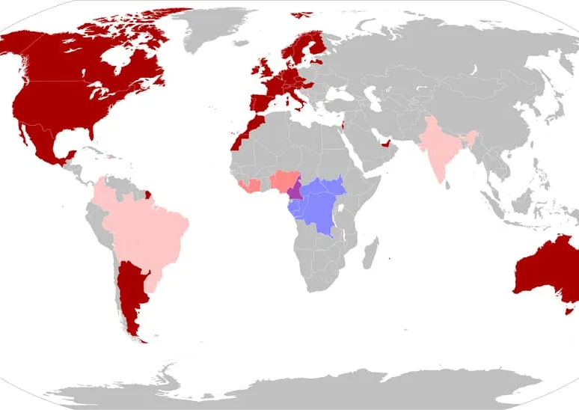

RCSI 43rd Annual International Nursing & Midwifery Research and Education Conference
Learning from the Mpox Public Health Emergency of International Concern
Dr John P Gilmore He/They
PhD RGN FHEA
Assistant Professor in Nursing
Fulbright HRB Health Impact Scholar

Slide 2
Aims of presentation
Describe context for the 2022 Mpox PHEIC with a particular focus on Ireland
Consider community needs analysis of gbMSM in Ireland during Mpox PHEIC
Discuss wider public health considerations from a global lens
Consider implications for nursing and health policy

Slide 3

Declarations
Community Needs Assessment of gbMSM commissioned by MPOWER Programme at HIV Ireland funded by HSE Sexual Health Crisis Pregnancy Programme

Slide 4
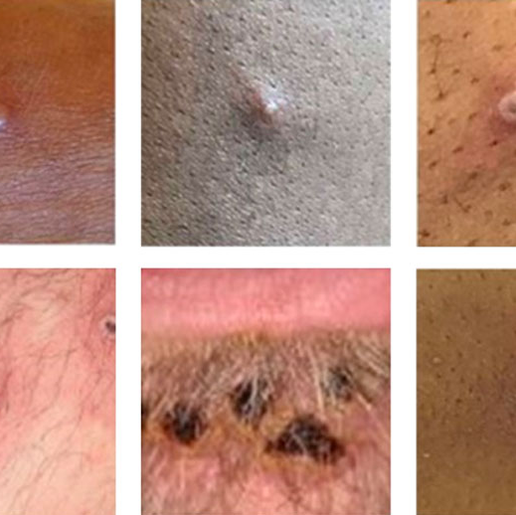
Mpox (formerly monkeypox)
Zoonotic disease related to smallpox
First discovered in 1958 in lab primates
Endemic in regions of central and western Africa
Clinical manifestation begins with flu-like symptoms and evolve into distinctive skin lesions
Transmitted via close skin-to-skin contact
Previously limited treatment/prevention tools
2022 rollout of Jynneos vaccine with good effect

Slide 5
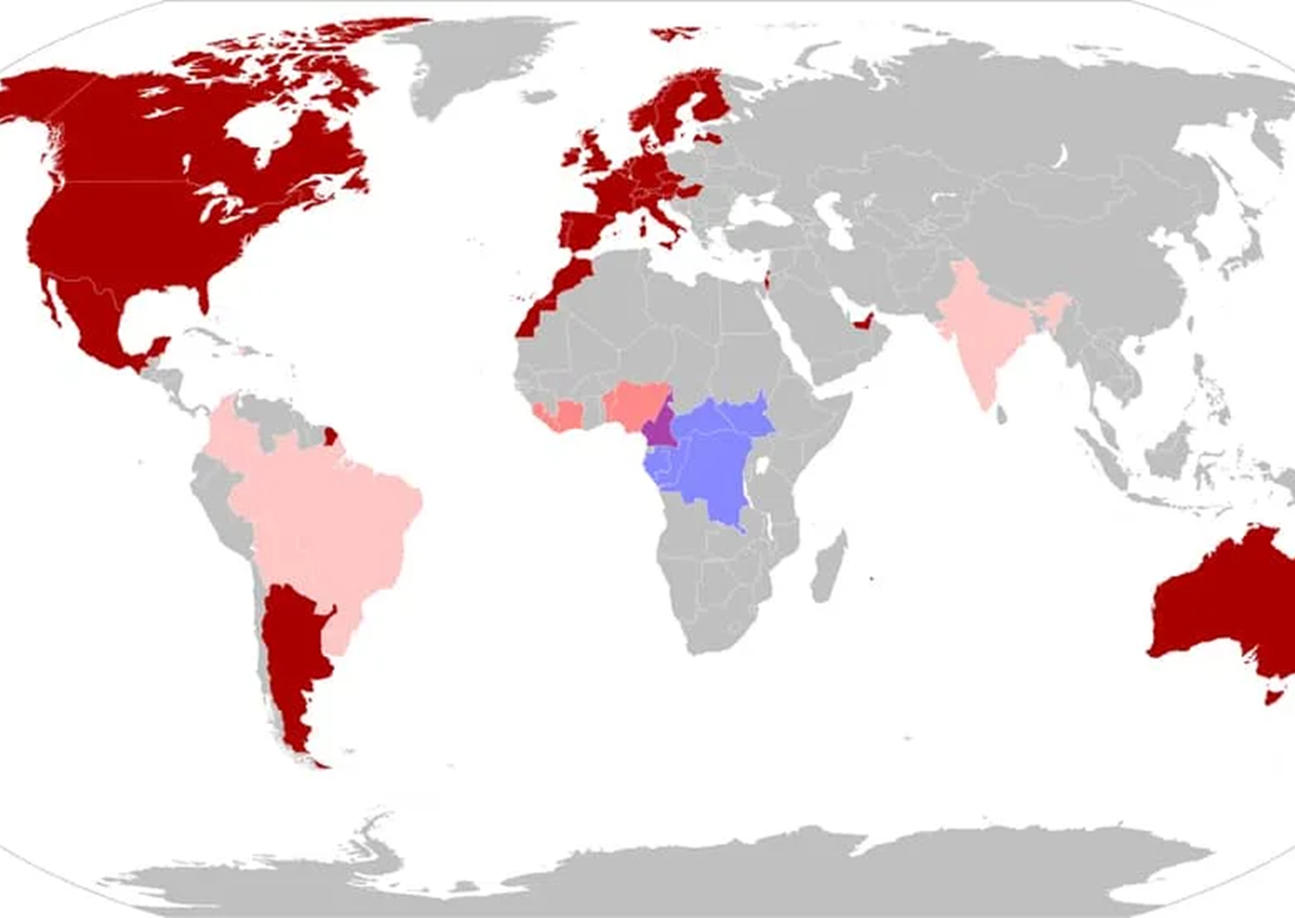
2022 Outbreak
Spring 2022 saw a surge of mpox (then monkeypox) being reported amongst communities of GBmsm globally
HSE emergency response team & DoH strategic advisory group established.
First cases in Ireland in late May 2022
PHEIC declared by WHO in July 2022
Limitations in early supply of vaccines & restrictions around rollout
Total of 228 cases during PHEIC majority in latter half of 2022
PHEIC declared over in May 2023

Slide 6

Community Needs Analysis
What are the thoughts and concerns of gbMSM in Ireland on the prevention, experience, and aftermath of mpox?
What is the impact of mpox on daily lives of gbMSM in Ireland?
What are the community preferences on the type of support and information provision on mpox?

Slide 7
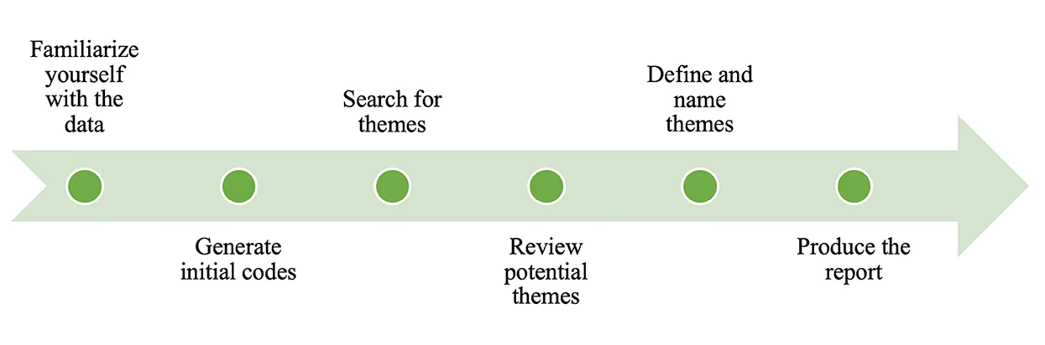
Methodology
Expert advisory group of clinicians, community organisations, public health experts and community members
Cross sectional, online, mixed methods survey (Braun et al 2021).
Data collection over six weeks
Descriptive statistical analysis
Reflexive Thematic & Critical Realist informed qualitative analysis (Koopmans & Schiller, 2022).
Braun and Clarke (2006; 2021)

Slide 8




Participants
Most dentified as gay (85.28%)
5 diagnosed with mpox prior to data collection (3.07%)
2 Assigned Female at Birth
Participants were primarily Irish (84.66%)
Lived in Dublin (57.06%)
163 participants
Aged 18-68 (M=39.56)
All participants
identified as male

Slide 9
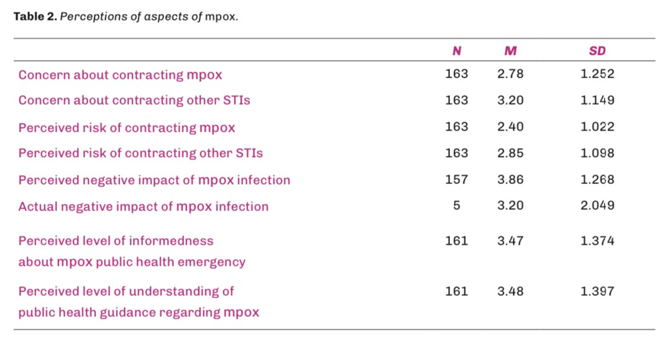
Perceptions of mpox
Concern about & perceived risk of contracting mpox were lower than for other STIs.
In this regard perceptions were likely reflective of actual risk of infection for mpox versus other STIs.
Somewhat high perceived negative impact of mpox; Reported negative impact for those diagnosed with mpox was slightly lower
Participants were moderately well informed about the mpox public health emergency and felt that they understood public health guidance reasonably well

Slide 10
Theme 1: Perceptions of the mpox response: divergence in urgency, priority and care.
The government response has been awful. It made little or no effort to reach everyone who needed support. The information supplied was minimal. There seemed to be a lack of urgency or understanding. (Gay man, 46-50, Meath)
Where is the public information campaign? Local groups, especially in the LGBT+ community are doing trojan work, but this should be a government-led response to what's supposed to be a public health emergency. (Gay man, 21-25, Dublin)
I reached out to my friends and lovers once I saw the vaccine was being released on a self-referral basis, I wanted to make sure everyone was looking after themselves sexually. (Gay man, 31-35, Galway)

Slide 11
Theme 2: The mpox outbreak as a sign of otherness for gbMSM.
Akin to coughing/sore throat symptoms in public during Covid - I became aware of my skin and appearance during this time. I have friends who have various skin conditions who were treated badly or asked prying questions during the summer [at the] height of symptoms and [when there was] no access to vaccines in particular. (Gay man, 31-35, Dublin)
[I’m] becoming a little more paranoid of judgements based around monkeypox [that] others may make of me if I openly disclose my orientation to new people. (Gay man, 18-20, Galway)

Slide 12
Theme 3: The potential for othering through mpox prevention practices.
"You must self-identify as slut to get [the vaccine]” (Gay man, 46-50, Galway)
I think the gay saunas in Dublin should be shut down on public health grounds given that every friend, and friends of friends, seems to regularly contract STIs in them. (Bisexual man, 46-50, Kerry)

Slide 13
Theme 4: Fear of mpox and the influence of previous culturally significant pandemics.
Here we go again, gay men being blamed [for] another disease (Gay man, 51-55, Dublin)
My anxiety has skyrocketed again as I feel like I’m missing out on living a part of my life that brings me joy. (Gay man, 31-35, Dublin)
The Irish gay community is already so fragile, I really don't want this to be another AIDS crisis, I don't think my poor heart could take it. (Gay man, 18-20, Galway)

Slide 14
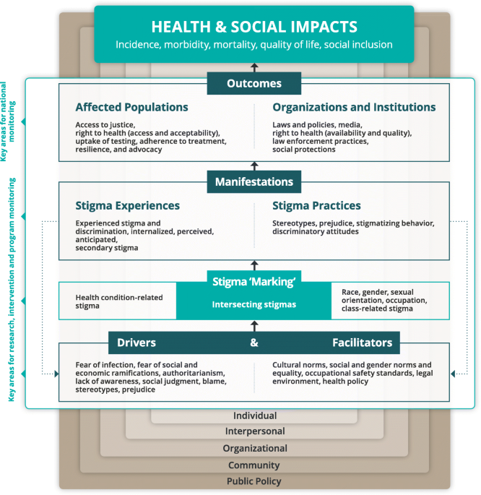
Discussion point 1
Stigma and Discrimination
Stigma as a driver of health inequity & harmful health behaviors (Stangl et al 2019)
Multiple layers of stigma: self-stigma, stigma by association, public stigma and structural stigma (Bos et al 2013)
Sexually Transmitted Infection vs Infection with possible sexual transmission (Garcia Iglesias et al 2022)
Discrimination and health seeking behaviours

Slide 15
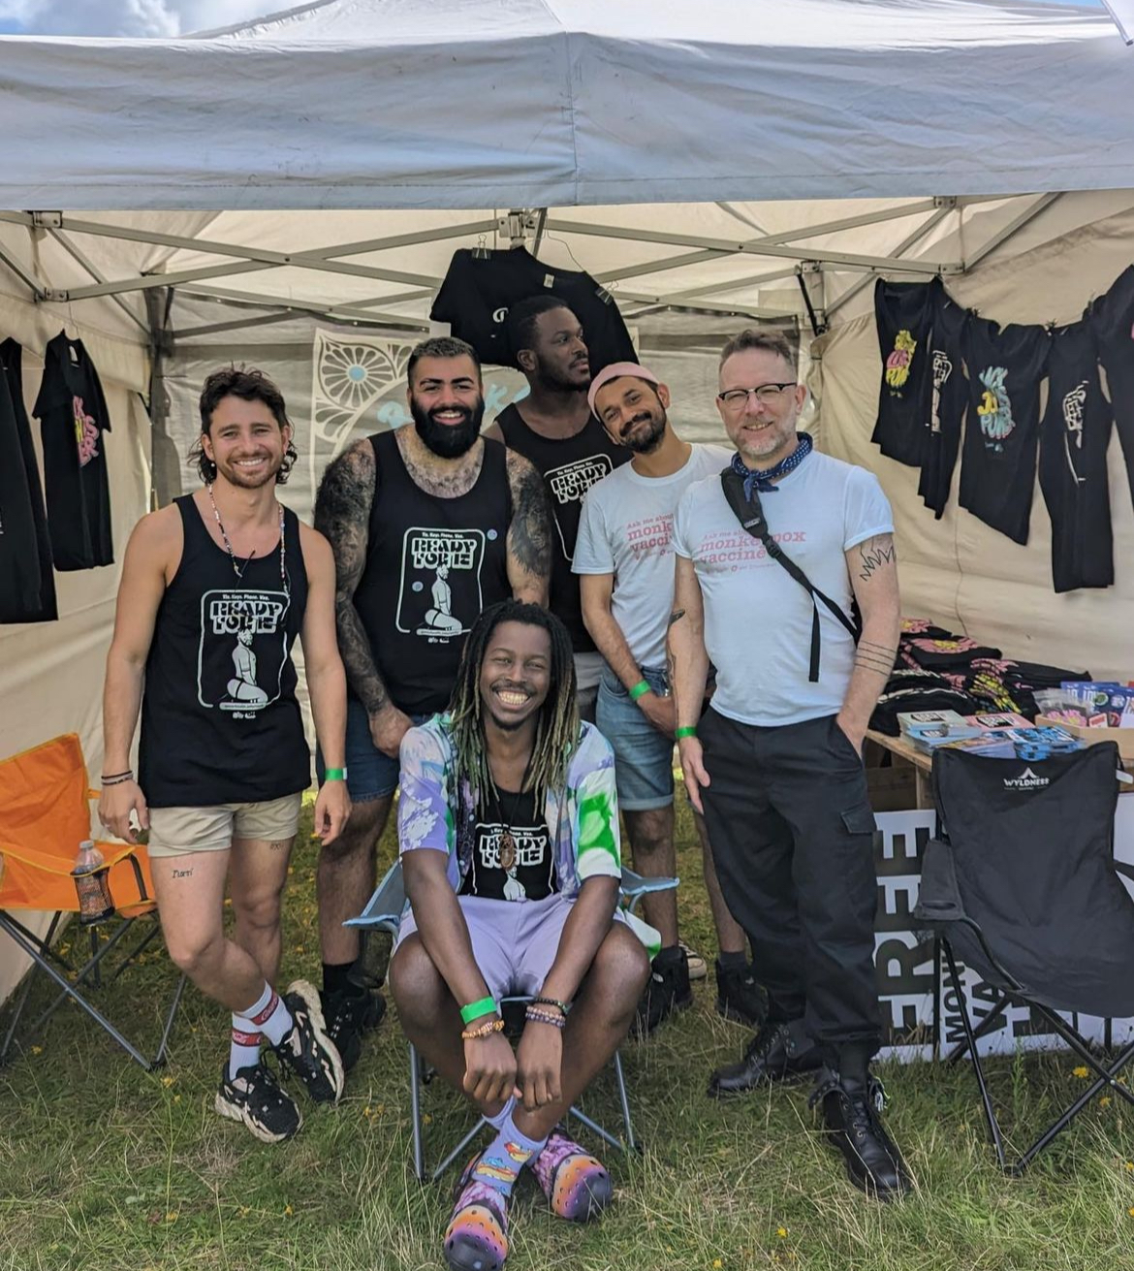
Discussion point 2
Community-Engaged Public Health
Focused attention without further stigmatizing GBMSM in the context of MPX (Holloway, 2022)
Recognition of community expertise
Flexibility in delivery – community vaccine clinics (Tweed et al. 2023)
Being open to challenge
Trauma-informed practice

Slide 16
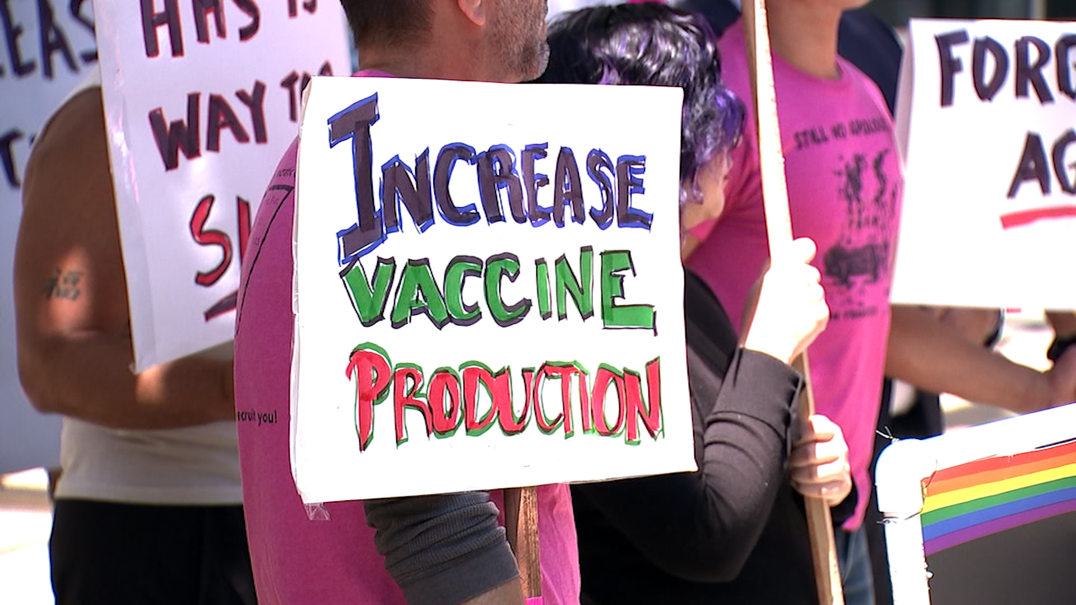
Discussion point 3
Global health inequities: Viruses don’t respect borders
No urgency & little interest to respond to mpox prior to 2022
1.2 Billion people with no access to vaccine (ACDCP, 2022)
Public health system with a reliance in donation
Fighting a war without any weapons (Ogunkola, 2023)
Notes:
The current dilemma with Mpox vaccine production and distribution is another example of the flaws in global health strategy that rely heavily on HICs to fight and treat illnesses. As evidenced by AIDS cases, COVID-19, and now Mpox, it is apparent that most enhanced global health measures to battle disease outbreaks generally come into play when the global north is affected, which causes more harm than benefit

Slide 17
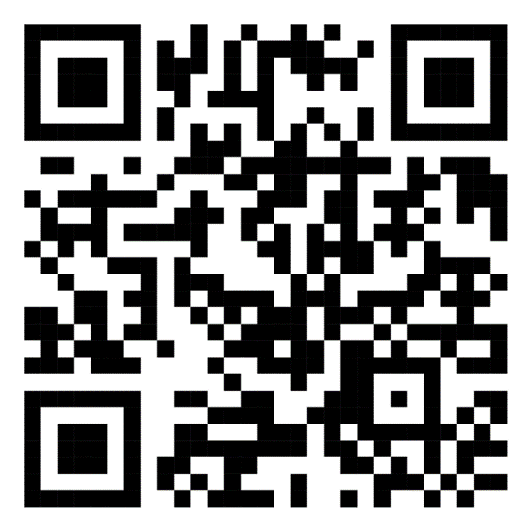
References
Africa Centres for Disease Control and Prevention (2022) Multi-country monkeypox outbreak declared a global public health emergency of international concern. https://africacdc.org/news-item/multi-country-monkeypox-outbreak-declared-a-global-public-health-emergency-of-international-concern-2/
Bos, A. E., Pryor, J. B., Reeder, G. D., & Stutterheim, S. E. (2013). Stigma: Advances in theory and research. Basic and applied social psychology, 35(1), 1-9.
Braun, V., & Clarke, V. (2006). Using thematic analysis in psychology. Qualitative Research in Psychology, 3(2), 77–101. https://doi.org/10.1191/1478088706qp063oa
Braun, V., & Clarke, V. (2019). Reflecting on reflexive thematic analysis. Qualitative Research in Sport, Exercise and Health, 11(4), 589–597. https://doi.org/10.1080/2159676X.2019.1628806
Garcia Iglesias, J., Nagington, M., Pickersgill, M., Brady, M., Dewsnap, C., Highleyman, L., Membrillo de Novales, F. J., Nutland, W., Thrasher, S., Umar, E., Muchamore, I., & Webb, J. (2023). Is mpox an STI? The societal aspects and healthcare implications of a key question. Wellcome open research, 7, 252. https://doi.org/10.12688/wellcomeopenres.18436.2
Holloway I. W. (2022). Lessons for Community-Based Scale-Up of Monkeypox Vaccination From Previous Disease Outbreaks Among Gay, Bisexual, and Other Men Who Have Sex With Men in the United States. American journal of public health, 112(11), 1572–1575. https://doi.org/10.2105/AJPH.2022.307075
Koopmans, E., & Schiller, D. C. (2022). Understanding Causation in Healthcare: An Introduction to Critical Realism. Qualitative Health Research, 32(8–9), 1207–1214. https://doi.org/10.1177/1049732322110573
Ogunkola, I. O., Abiodun, O. E., Bale, B. I., Elebesunu, E. E., Ujam, S. B., Umeh, I. C., Tom-James, M., Musa, S. S., Manirambona, E., Evardone, S. B., & Lucero-Prisno, D. E., 3rd (2023). Monkeypox vaccination in the global south: Fighting a war without a weapon. Clinical epidemiology and global health, 22, 101313. https://doi.org/10.1016/j.cegh.2023.101313
Stangl, A. L., Earnshaw, V. A., Logie, C. H., van Brakel, W., C Simbayi, L., Barré, I., & Dovidio, J. F. (2019). The Health Stigma and Discrimination Framework: a global, crosscutting framework to inform research, intervention development, and policy on health-related stigmas. BMC medicine, 17(1), 31. https://doi.org/10.1186/s12916-019-1271-3
Tweed, M., Fortescue-Talwar, K., Finn, R., Buonsenno, L., Nichols, K., Frem, J., Darking, M., Nicholson, S., Williams, D., & Richardson, D. (2023). Delivering a community-based monkeypox vaccination programme in partnership. International journal of STD & AIDS, 34(6), 427–429. https://doi.org/10.1177/09564624231155995

Slide 18

Acknowledgements
Participants in research
Co-researchers David Comer, Dr Chris Noone
Adam Shanley and MPOWER Team
Global teams of activists championing health justice and equity

Slide 19
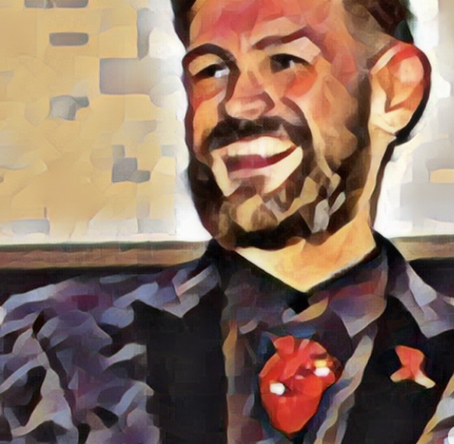

Thank you
John.Gilmore@ucd.ie
@GilmoreJNurse

